Slide 1
Mad Science:
India Ink & Watercolor
Karl Stephan, Visiting Artist | Ms. Groenstein, Art | Academy of Aerospace & Engineering

Slide 2
“Is it possible to achieve results similar to the best oil paintings using India ink and watercolor?”
Once a “ladies activity” painting in watercolor is faster, cleaner and “greener” than oil painting.
Notes:
This is the question that your experiment answers

Slide 3
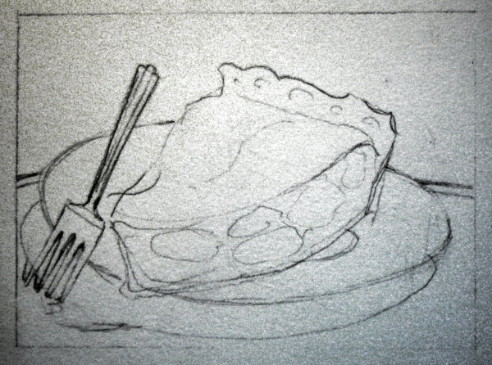
“I Didn’t Get My Pie” Step 1: Pencil Drawing
HINT: Keep your drawing loose and simple. I prefer objects life-size.

Slide 4
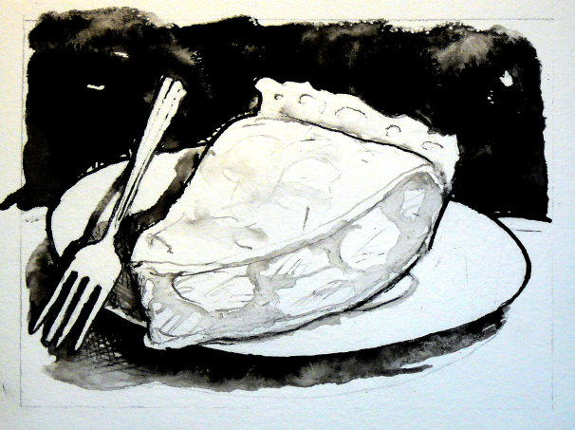
“I Didn’t Get My Pie” Step 2: India Ink Pen and Wash
HINT: Interesting background and shadows can be created by painting in clear water then adding ink and letting it flow.

Slide 5
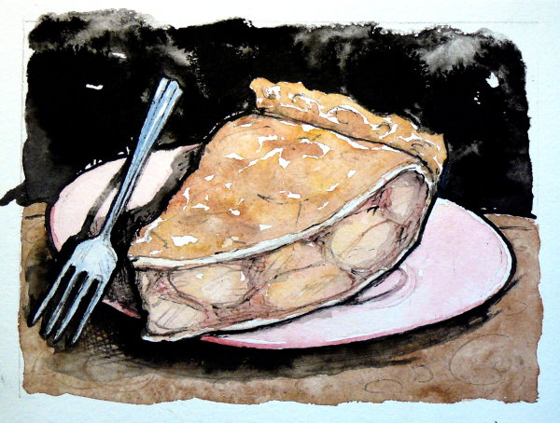
“I Didn’t Get My Pie” Step 3: Some Watercolor Added
NOTE: Color may be added at any time, but I find it’s easier to control if applied after the ink dries. However adding ink to wet watercolor or vice-versa can give interesting results.

Slide 6
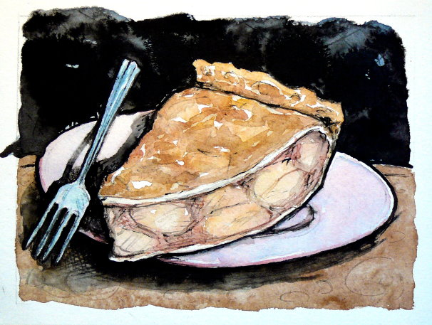
“I Didn’t Get My Pie” Step 4: Additional Watercolor and Ink
“I Didn’t Get My Pie” India Ink and Watercolor © Karl Stephan 2014. All rights reserved.

Slide 7
Test: can oil paintings of acknowledged masters be successfully emulated by this method?
Candidates for comparison:
  Juan Sánchez Cotán, Spain, 16th century
  Édouard Manet, France 19th century
  Paul Cézanne, France, 19-20th century
  Others…?
NOTE: I chose some of my favorites – use these or pick your own!
Notes:
Summarize your research in three to five points.

Slide 8
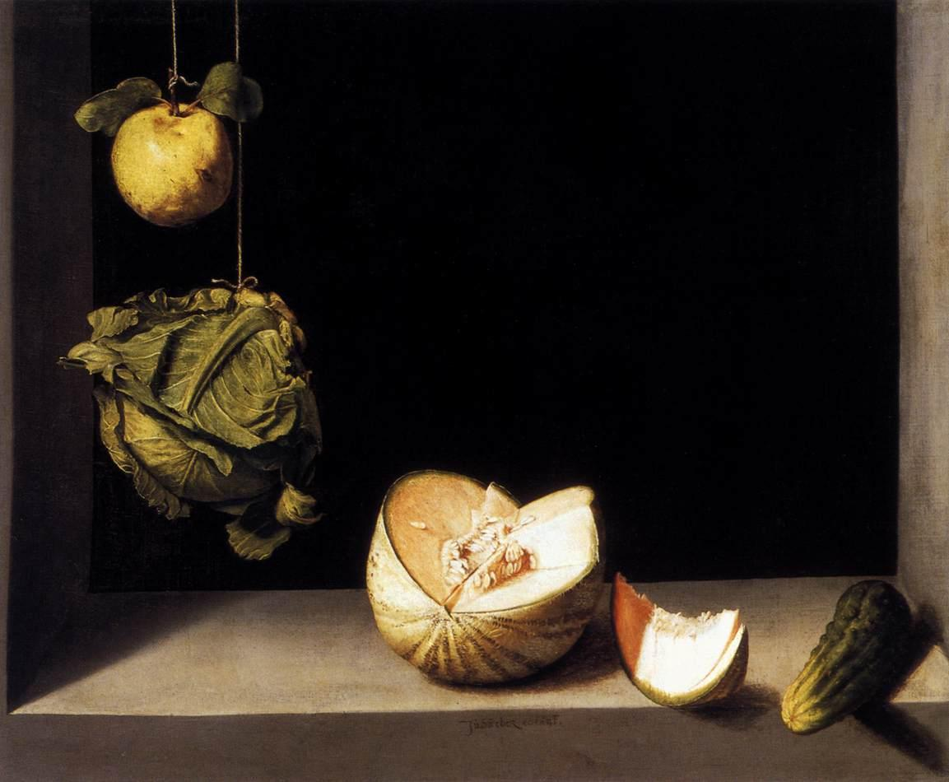
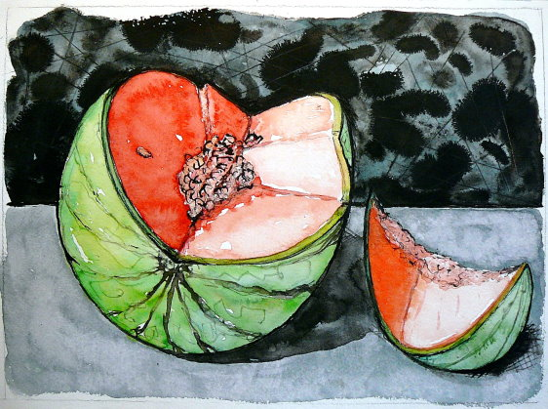
Juan Sánchez Cotán, 1560-1627, Baroque

Slide 9
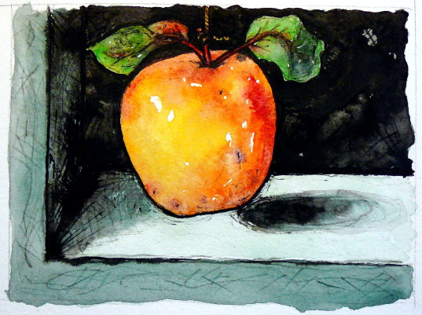
Juan Sánchez Cotán
A pioneer of realism, his still lives were also called bodegones.
“Quince on a String” India Ink and Watercolor © Karl Stephan 2014. All rights reserved.

Slide 10
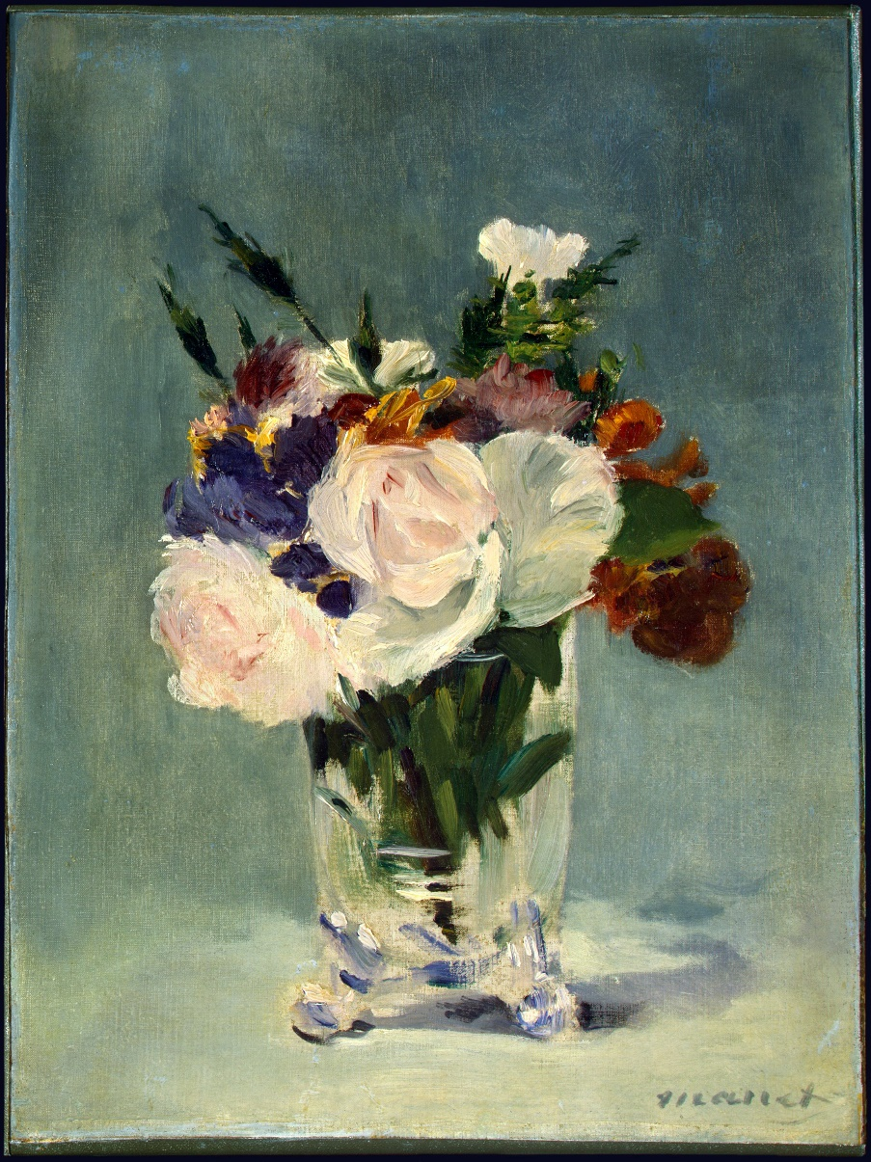
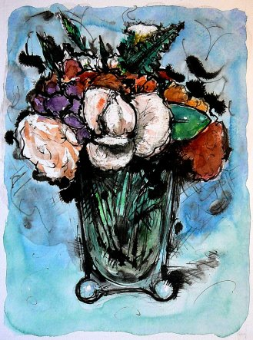
Édouard Manet, 1832-83, Impressionism

Slide 11
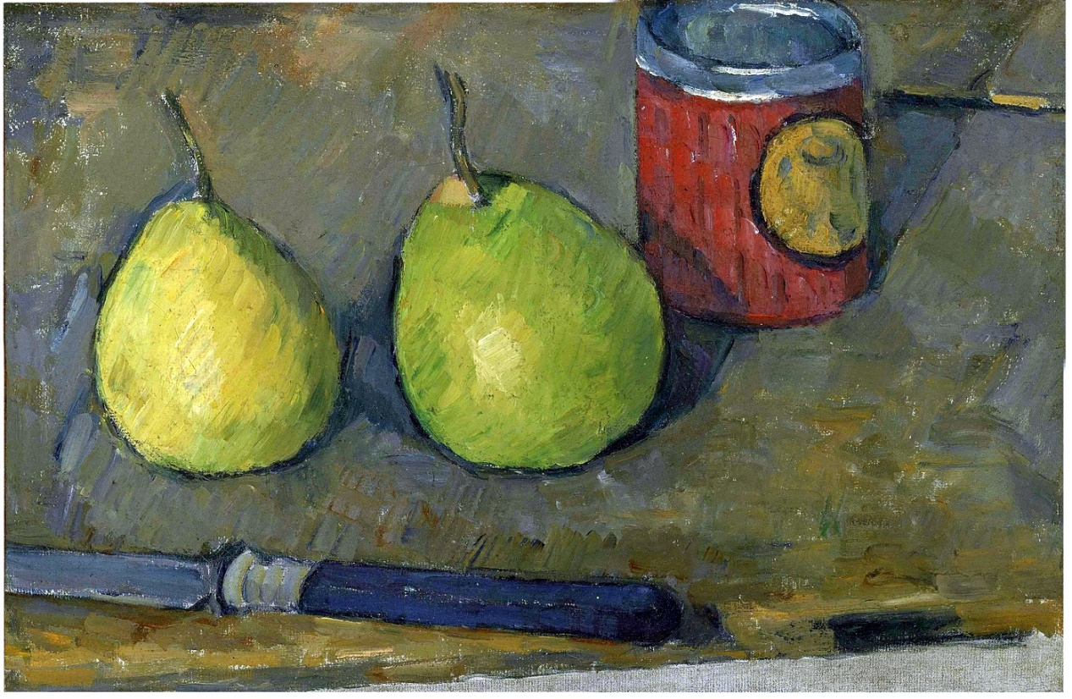
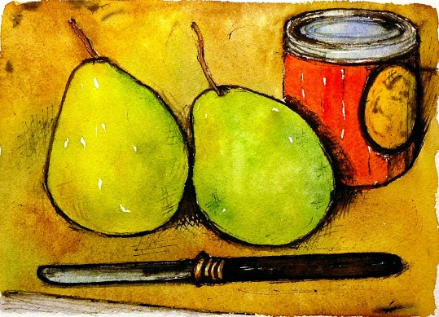
Paul Cézanne, 1839-1906, Post-Impressionism

Slide 12
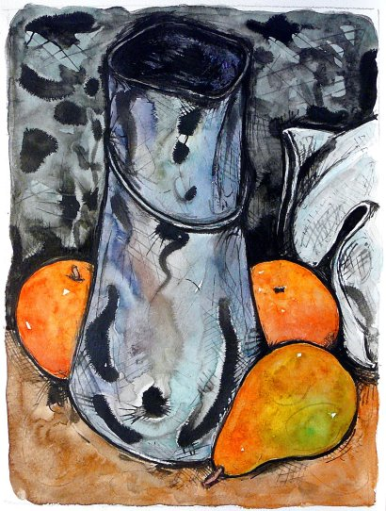
Paul Cézanne
A bridge between Impressionism and Cubism.
“Milk Can” India Ink and Watercolor © Karl Stephan 2014. All rights reserved.

Slide 13
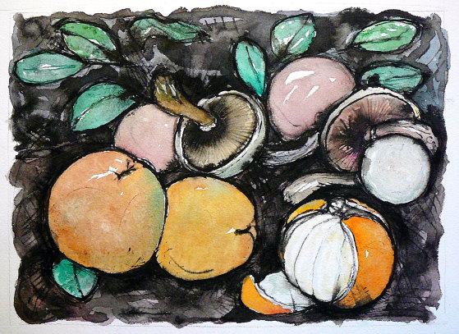
Giovan Battista Ruoppolo
(1629–1693)
Baroque
“Apples and Mushrooms” India Ink and Watercolor © Karl Stephan 2014. All rights reserved.

Slide 14
Notes on the Tradition
Your teacher and my good friend Ms. Groenstein is a superbly talented artist and educator. Treasure her and learn all you can! Painting is an ancient skill handed on from one generation to another. She is handing it to you.
I was fortunate to be mentored by artist Roy Nydorf, is one of the great painters in the world today. Roy in turn studied at Yale with William Bailey, an acknowledged 20th century master. I even took a painting class with Mr. Bailey. Although we disagreed, I respect his work tremendously.
I believe I am the only artist in the world using the ink and watercolor technique shown in this presentation. It is based on knowledge given to me by artists I’ve been fortunate to know. Just as freely, I am giving it to you. Welcome to the great tradition of painting!

Slide 15
Thank You!

